Slide 1
A Reinforcement Learning Approach for Solving Chess Endgames
Zacharias Georgiou (S3009874)
Evangelos Karountzos (S2705532)
Yaroslav Shkarupa (S3017125)
Matthia Sabatelli (S2847485)

Slide 2
Introduction
Chess and AI
Chess endgames
Our project
Reinforcement Learning
Q-Learning
TD-Learning
Results
Final demo

Slide 3
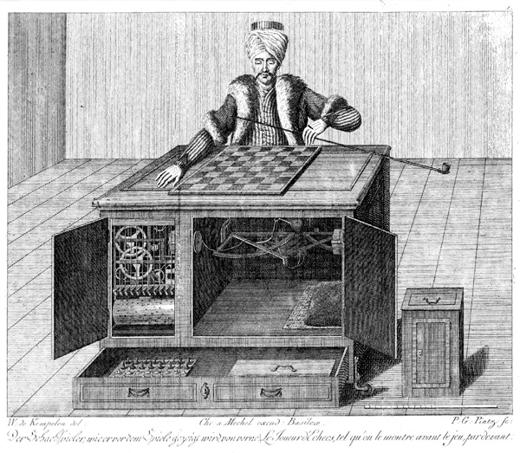
Chess and AI

Slide 4
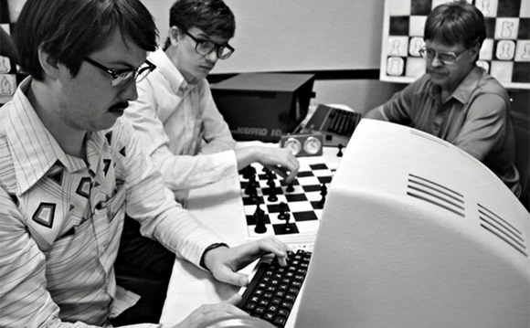
Chess and AI

Slide 5
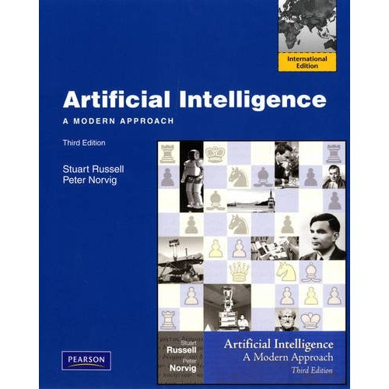
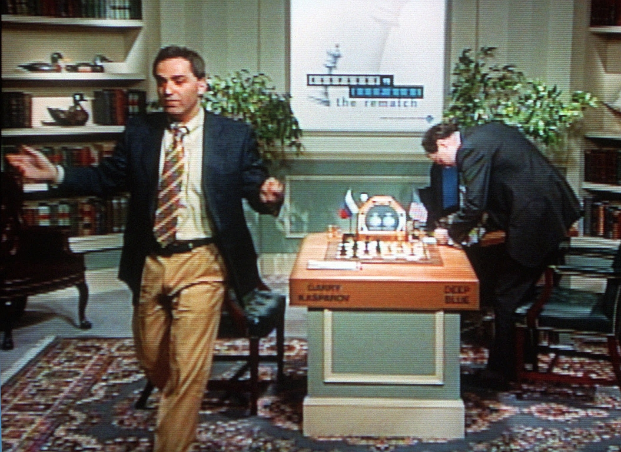
Chess and AI

Slide 6
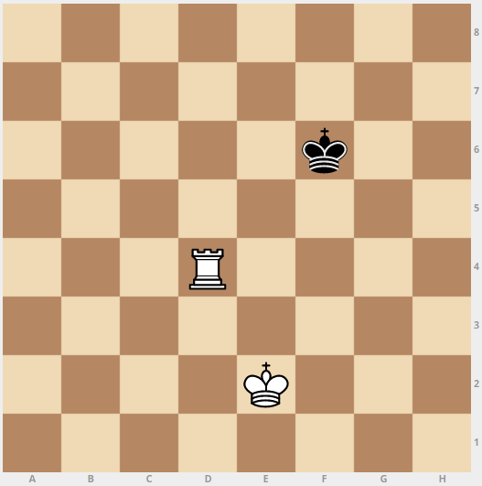
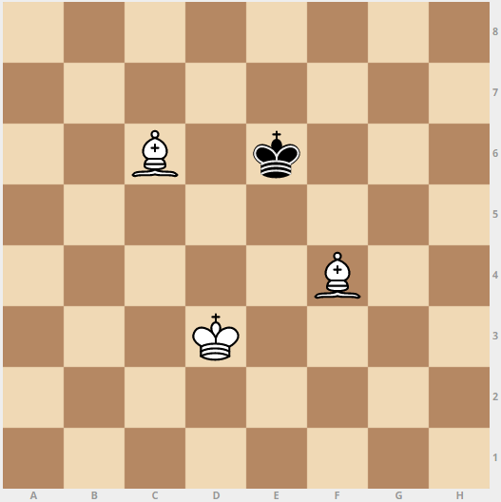
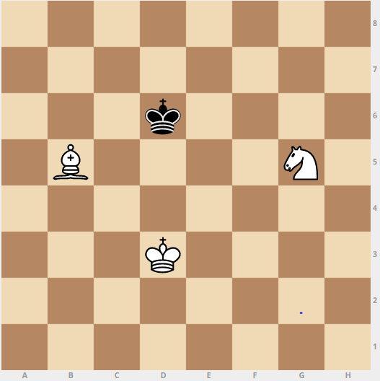
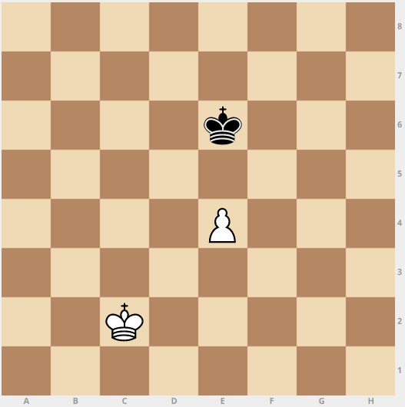
Chess endgames

Slide 7
Our Project
King-Rook-King endgames
We taught the white player to win

Slide 8

Our Project
Machine Learning Method: Reinforcement Learning
Learning Algorithm: Q-Learning vs. TD-learning(?)
Starting from a random position
Policy: Random exploration
Creation of a basic memory (with all the possible states 64^3)
Training of the agent

Slide 9
Chess endgames

Slide 10
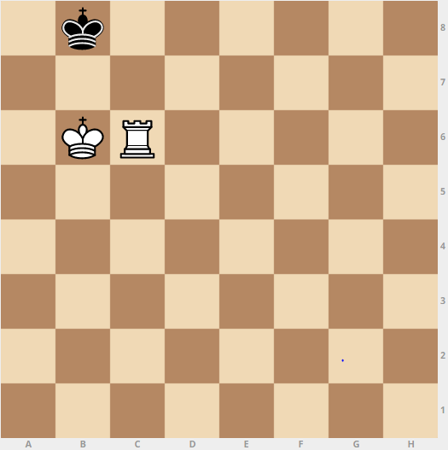
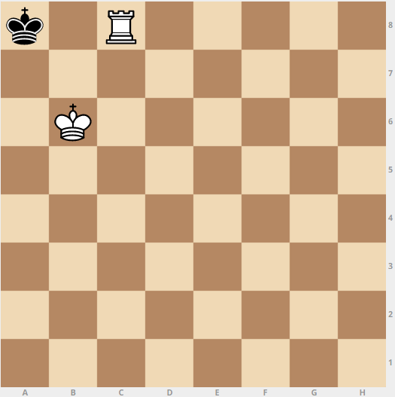
Current State,
State +1, Reward = 1

